Slide 1
CLIL HISTORY THE TWENTIETH CENTURY
Prof.ssa Magnani &
Prof. Masè

Slide 2
WHAT DOES CLIL MEAN?
IT STANDS FOR CONTENT AND LANGUAGE INTEGRATED LEARNING
THIS IS WHERE STUDENTS STUDY A SUBJECT THROUGH A LANGUAGE THAT IS NOT THEIR OWN MOTHER TONGUE
AND SO WHAT DOES IT MEAN???

Slide 3
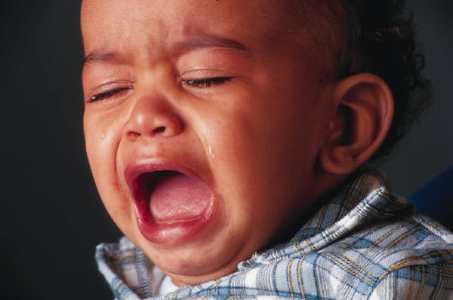
WHAT IS IT?

Slide 4
IT MEANS …
YOU WILL BE LEARNING ABOUT HISTORY THROUGH ENGLISH…
IT IS AMAZING, ISN’T IT?
GOOD LUCK

Slide 5
OUR THREE D.D.D.
DISCUSS
DEVELOP YOUR LINGUISTIC AND COMMUNICATIVE COMPETENCIES
DO YOUR BEST.. YOU CAN MAKE IT!!

Slide 6
MODULE 1: SOCIETY IN THE EARLY 1900S
THE EMERGENCE OF MASS SOCIETY
THE BEAUTIFUL ERA “BELLE EPOQUE”
THE “SUFFRAGETTE MOVEMENT”

Slide 7
MODULE 2: THE FIRST WORLD WAR
DEFINING THE IDEA OF NATION
NATIONALISM: CONTEMPORARY TRENDS
EVERYDAY LIFE DURING THE FIRST WORLD WAR

Slide 8
MODULE 3: BETWEEN THE TWO WORLD WARS
THE JAZZ AGE: 1921 -1929
THE GREAT DEPRESSION IN THE USA
LIFE DURING THE GREAT DEPRESSION

Slide 9
MODULE 4: THE SECOND WORLD WAR
LIFE IN THE UK DURING THE WAR
THE HOLOCAUST

Slide 10
MODULO 5 POST- IMPERIALISM: THE CASE OF INDIA
MAHATMA GHANDY

Slide 11
MODULE 6 THE COLD WAR
FROM THE AMERICAN POINT OF VIEW
THE CIVIL RIGHTS MOVEMENT
THE VIETNAM WAR

Slide 12
MODULE 7 EDUCATION & WOMEN
WOMEN ‘S RIGHTS
WOMEN’S DUTIES
YOUTH AND EDUCATION UNDER TOTALITARIAN REGIMES

Slide 13
IT IS A CHALLENGE: IT’S UP TO YOU!!!

