Slide 1
THE BELLE EPOQUE
THE BEAUTIFUL ERA

Slide 2
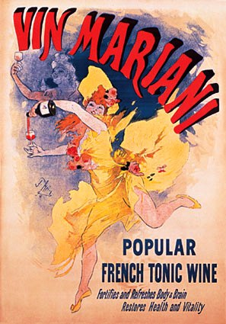
The Belle Époque or La Belle Époque ("Beautiful Era") was a period of Western European history. It is conventionally dated from the end of the Franco-Prussian War in 1871 to the outbreak of World War I in 1914.
It was a period characterized by optimism, regional peace, economic prosperity and technological, scientific and culture innovations. In the climate of the period, especially in Paris, the arts flourished.
Many masterpieces of literature, music, theater, and visual art gained recognition. The Belle Époque was named, in retrospect, when it began to be considered a "golden age" in contrast to the horrors of World War I.
A French poster from 1894 by Jules Chéret that captures the vibrant spirit of the Belle Époque.

Slide 3
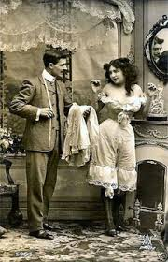
POPULAR CULTURE AND FASHIONS
A TIME OF JOIE DE VIVRE (JOY OF LIVING) IN CONTRAST TO 20th CENTURY HARDSHIPS
A PERIOD OF STABILITY THAT WAS ENJOYED BY FRANCE
PARIS: THE CULTURAL CENTER OF GLOBAL INFLUENCE
EDUCATIONAL, SCIENTIFIC AND MEDICAL INSTITUTIONS WERE AT THE TOP

Slide 4
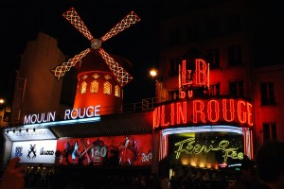
THE MOULIN ROUGE
ENTERTAINMENT WAS PROVIDED BY CABARETS, BISTROS AND MUSIC HALLS
THE CASINO DE PARIS OPENED IN 1890
THE MOULIN ROUGE CABARET (IT IS STILL OPENED)
BURLESQUE PERFORMANCE STYLES

Slide 5
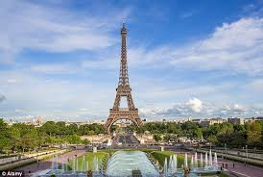
THE EIFFEL TOWER
BUILT IN 1889
TO SERVE AS THE GRAND ENTRANCE TO THE 1889 WORLD’S FAIR HELD IN PARIS
IT WAS BUILT IN 2 YEARS, 2 MONTHS AND 5 DAYS
324 METERS
IN 1909 THEY WANTED TO DEMOLISH IT BECAUSE OF THE LITERATE AND CULTURAL PEOPLE

Slide 6
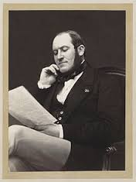
PARIS HAS CHANGED…
BARON GEORGES-EUGENE HAUSSMANN
THE PREFECT OF THE SEINE DEPARTMENT
CHOSEN BY THE EMPEROR NAPOLEON III TO CARRY OUT A MASSIVE PROGRAM OF NEW BOULEVARDS, PARKS AND PUBLIC WORKS
“HAUSSMANN’S RENOVATION OF PARIS”

Slide 7
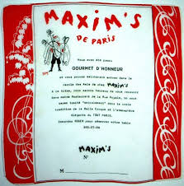
FRENCH COUSINE
FRENCH COUSINE WAS IN THE ESTEEM OF EUROPEAN GOURMETS
“RITZY”: WORD INVENTED IN THIS ERA. IT REFERS TO THE POSH ATMOSPHERE AND CLIENTS OF THE HOTEL RITZ PARIS
CHAMPAGNE WAS PERFECTED
THE ALCOHOLIC SPIRIT ABSINTHE: A MUSE AND INSPIRATION FOR MANY ART NOUVEAU ARTISTS

Slide 8
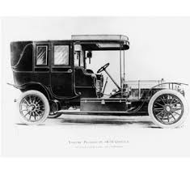
SCIENCE AND TECHNOLOGY
AN ERA OF GREAT SCIENTIFIC AND TECHNOLOGICAL IMPROVEMENT IN EUROPE AND THE WORLD IN GENERAL
THE PERFECTION OF LIGHTLY SPRUNG, NOISELESS CARRIAGES IN SEVERAL NEW FASHIONABLE FORMS
FRENCH AUTOMOBILE: PEUGEOT
EDOARD MICHELIN INVENTED REMOVABLE PNEUMATIC TIRES FOR BICYCLES AND CARS
SCOOTER AND MOPED WERE INVENTED

Slide 9
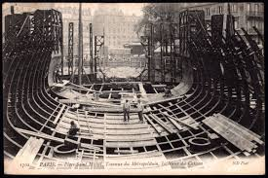
POLITICS
AN UNUSUAL POLITICAL STABILITY IN WESTERN AND CENTRAL EUROPE
STILL TENSIONS BETWEEN THE FRENCH AND GERMAN GOVERNMENTS (BECAUSE OF THE FRENCH LOSS OF ALSACE-LORRAINE TO GERMANU IN 1871)
AN UPPER CLASS GENTLEMAN COULD TRAVEL THROUGH MUCH OF WESTERN EUROPE WITHOUT A PASSPORT
IT FEATURED A CLASS STRUCTURE THAT ENSURED CHEAP LABOR
THE PARIS METRO WAS BUILT

Slide 10
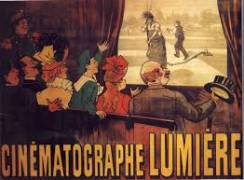
SCIENCE AND TECHNOLOGY
FRANCE: A LEADER OF EARLY CINEMA TECHNOLOGY
THE CINEMATOGRAPHE WAS INVENTED BY LEON BOULY AND PUT TO USE BY AUGUSTE AND LOUISE LUMIERE
THE FIRST FILM SCREENINGS IN THE WORLD

Slide 11
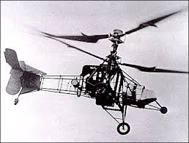
SCIENCE AND TECHNOLOGY
FRANCE: A LEADER IN AVIATION
THE WORLD’S FIRST NATIONAL AIR FORCE IN 1910
LOUIS BREGUET AND PAUL CORNU DID THE FIRST FLYING HELICOPTERS IN 1907
HENRY BECQUEREL DISCOVERED RADIOACTIVITY IN 1896
BIOLOGISTS AND PHYSICIANS CAME TO UNDERSTAND THE GERM THEORY OF DISEASE (PASTEURISATION), APPLIED AND PURE MATHEMATICS

Slide 12
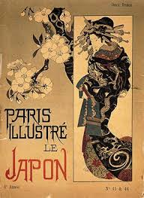
ART AND LITERATURE
1890 VINCENT VAN GOGH DIED
DURING THE 1890S HIS PAINTINGS ACHIEVED THE ADMIRATION
REACTION AGAINST THE IDEALS OF IMPRESSIONISTS
EXPRESSIONISM ARTISTS IN PARIS AND VIENNA
EARLY WORKS OF CUBISM AND ABSTRACTION

Slide 13
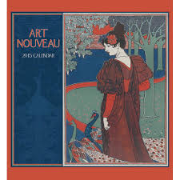
ART AND LITERATURE
THE SPREAD OF ART NOUVEAU
A LARGELY DECORATIVE STYLE, CHARACTERIZED BY ITS CURVILINEAR FORMS
PAUL GAUGUIN, HENRI MATISSE, HENRI ROUSSEAU AND A YOUNG PABLO PICASSO

Slide 14
ART AND LITERATURE
EUROPEAN LITERATURE HAD A MAJOR TRANSFORMATION
FRENCH REALIST OR NATURALIST AUTHORS ARE GUY DE MAUPASSANT AND EMILE ZOLA
REALISM GRADUALLY DEVELOPED INTO MODERNISM
MUSICALLY, THE SALON MUSIC
MODERN DANCE BEGAN TO EMERGE AS A POWERFUL ARTISTIC DEVELOPMENT IN THEATRE

Slide 15
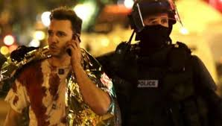
FRANCE – PARIS 13.11.2015

